Slide 1

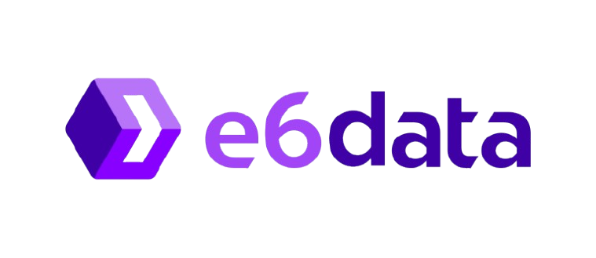
HACKATHON PROJECT OVERVIEW
Project Name: [MetaVision – Visualize and manage metadata with ease]
Problem Statement & ID: [Metastore Viewer for Parquet, Iceberg, Delta & Hudi Tables on S3 ]
Team Name: [Syntax Terror]
College: [VIT PUNE]
City: [PUNE]

Slide 2
PROPOSED SOLUTION
IDEA:
Develop a web-based metastore viewer to explore metadata (schema, partitions, snapshots, metrics) for Parquet, Iceberg, Delta, and Hudi tables directly from S3/Azure/MinIO bucket paths.
Features: Auto-detection of table formats, interactive charts for key metrics, AI-driven analysis for storage optimization, and real-time collaboration for team-based metadata exploration.
Also supports file upload for quick analysis of individual files.
HOW IT WORKS:
User Input: Provide an object store path (S3/Azure/MinIO)
Backend: Connects to object stores, parses metadata files, extracts schema, partitions, properties, and versioning details, and exposes metadata via REST API.
Frontend: Interactive UI for schema visualization, partition details, versioning, sample data, and charts for key metrics.
Additional Features: Trino integration for SQL queries, being able to add comments to keep a log of changes and Metadata Comparison: Track schema changes over time.

Slide 3
PROPOSED SOLUTION
How It Addresses the Problem:
Direct Metadata Access: Connects to object stores (S3/Azure/MinIO) to parse metadata files, eliminating the need for traditional metastore services.
User-Friendly Exploration: Interactive UI visualizes schema, partitions, versioning, and sample data for easy analysis.
Innovation & Uniqueness:
Auto-Detection: Identifies table formats (Parquet, Iceberg, Delta, Hudi) automatically.
AI-Driven Insights: Offers storage optimization and schema evolution recommendations.
Real-Time Collaboration: Enables team-based metadata exploration.
Trino Integration: Direct SQL querying on discovered tables.
Metadata Comparison: Tracks and visualizes schema changes over time.
No Metastore Dependency: Works directly with object stores for seamless access.

Slide 4
APPROACH
STEP-1 : S3 Interaction
Using AWS SDK (Boto3) to fetch metadata files:
Iceberg: metadata.json, manifest.
Delta: _delta_log, checkpoints.
Hudi: .hoodie timeline.
Parquet: File footers.
STEP-2 : Metadata Parsing
Iceberg: Extracting schema evolution and snapshots from metadata.json and manifests.
Delta: Parsing _delta_log for commits and checkpoints.
Hudi: Analyzing .hoodie files for schema and commit history.
Parquet: Using PyArrow to extract schema and row group metadata.
STEP-3 : API Design
Framework: FastAPI or Flask for REST API.
Endpoints:
/get-schema: Table schema and data types.
/get-partitions: Partition stats.
/get-snapshots: Snapshots/versioning.
/get-metrics: File size, row counts.

Slide 5
USPs & Features
With the growing adoption of cloud-based data storage, efficiently viewing metadata has become critical. Our AI-powered, web-based collaborative platform offers:
Quick metadata insights with an intuitive UI.
Charts and visualizations for better data interpretation.
Features
USPs
Interactive Visualizations:
Detailed graphs and charts for clear metadata insights.
Unified Platform:
Explore Parquet, Iceberg, Delta, and Hudi tables without needing a metastore.
AI-Powered Optimization:
Analyze metadata to suggest storage efficiencies and query pruning.
Track schema evolution and predict trends.
Real-Time Collaboration:
Work seamlessly with team members on shared metadata exploration.
Enable dynamic updates and discussions in real time.
Personal Accounts:
Maintain search history for easy reference.
Customize your workspace for better productivity.

Slide 6
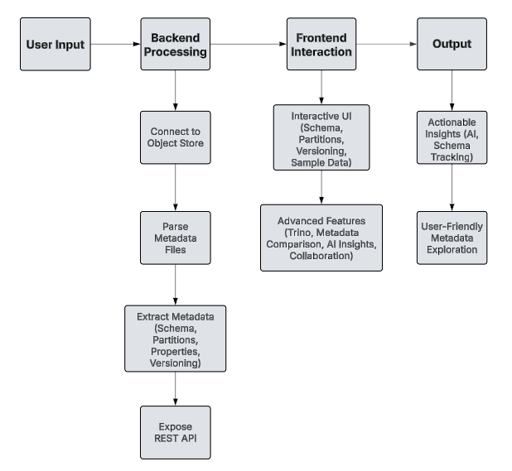
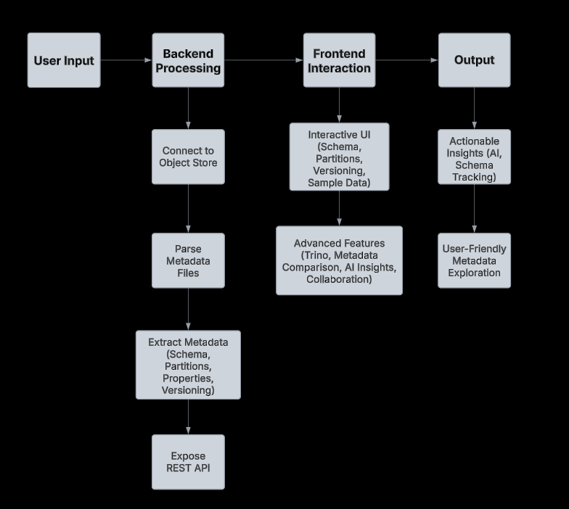
Technologies & Implementation
Tech Stack:
Programming Languages: Javascript, Python
Storage: Amazon S3, MinIo
Visualisation : D3.js, Chart.js
Frameworks: React, Express
Databases: MongoDB
Implementation Methodology:

Slide 7
Potential Impact
For Data Engineers
Directly parse S3 metadata using Boto3 and PyArrow—no Hive metastore required.
Example: schema = pq.read_schema('s3://bucket/table').
For Analysts
Query tables effortlessly with Trino: SELECT * FROM s3.table.
Instantly view schemas, partitions, and table details via an interactive React UI.
For Teams & Organizations
API Integration:
Example: GET /metadata/s3://bucket → {schema, size, partitions}.
Optimize costs with detailed file size metrics (e.g., "Table size: 1.2GB").
Key Advantages
Unified Solution: Support for Parquet, Iceberg, Delta, and Hudi in one tool.
AI-Enhanced: Predict partition pruning and track schema changes using Delta logs.
High Performance: RESTful API + Trino ensure fast, lag-free operations without a metastore.
Impact on Target Audience
Benefits of the Solution:
Social Impact
Economic Benefits
Environmental Contributions

Slide 8
References & Additional Links
R. Blue and D. Weeks, “Apache Iceberg: A modern table format for S3 data lakes,” in Proc. IEEE Int. Conf. Data Eng. (ICDE), 2020. [Online]. Available: https://www.dremio.com/subsurface/apache-iceberg-a-modern-table-format-for-big-data/
V. Chandar, B. Varadarajan, and N. Agarwal, “Apache Hudi: Towards incremental data processing in cloud warehouses,” in Proc. IEEE Int. Conf. Big Data (Big Data), 2020. [Online]. Available: https://hudi.apache.org/docs/overview/
V. Chandar, B. Varadarajan, and N. Agarwal, “Apache Hudi: Towards incremental data processing in cloud warehouses,” in Proc. IEEE Int. Conf. Big Data (Big Data), 2020, pp. 1373–1382. [Online]. Available: https://doi.org/10.1109/BigData50022.2020.9378432
J. Le Dem and N. Li, “Parquet: Columnar storage for the people,” in Proc. IEEE Int. Conf. Data Eng. (ICDE), 2013, pp. 1250–1251. [Online]. Available: https://doi.org/10.1109/ICDE.2013.6544832
Links to References & Research Papers
Prototype Link (if available)
Additional Documentation

Slide 9
Team Details
Name | Year | Branch | College | Email
Rahul Shendre | SY | IT | VIT,PUNE | rahulshendre789@gmail.com
Shantanu Rajurkar | SY | IT | VIT,PUNE | shantanurajurkar0@gmail.com
Aryan Pungale | SY | AI&DS | VIT,PUNE | aryanpungle45@gmail.com
Ishan Kale | SY | AI&DS | VIT,PUNE | keshavraokale6@gmail.com

